Slide 1

Loss Minimization Control of an Induction Motor Drive
By
Aditya Kumar
(Roll no. 24M1355)
M.Tech (1st year)
Subject – EN 659
Under the guidance of
Prof. V.S.S. Pavan Kumar Hari
Department of Energy Science and Engineering
Indian Institute of Technology Bombay, Powai, 400076
May 2025

Slide 2
Problem Statement
Conventional V/f drives do not ensure optimal efficiency, especially at light loads.
Efficiency drops with nonlinear torque-speed loads like fans or pumps.
Existing methods need accurate motor parameters, which vary with temperature and are hard to measure.
A parameter-independent control is needed to reduce losses while maintaining torque and speed.
Introduction
Types of inverter fed adjustable-speed IM drives
Open loop
Closed-loop
Cost effective but may not operate at max ɳ
Increased ɳ but require accurate model parameter knowledge

Slide 3
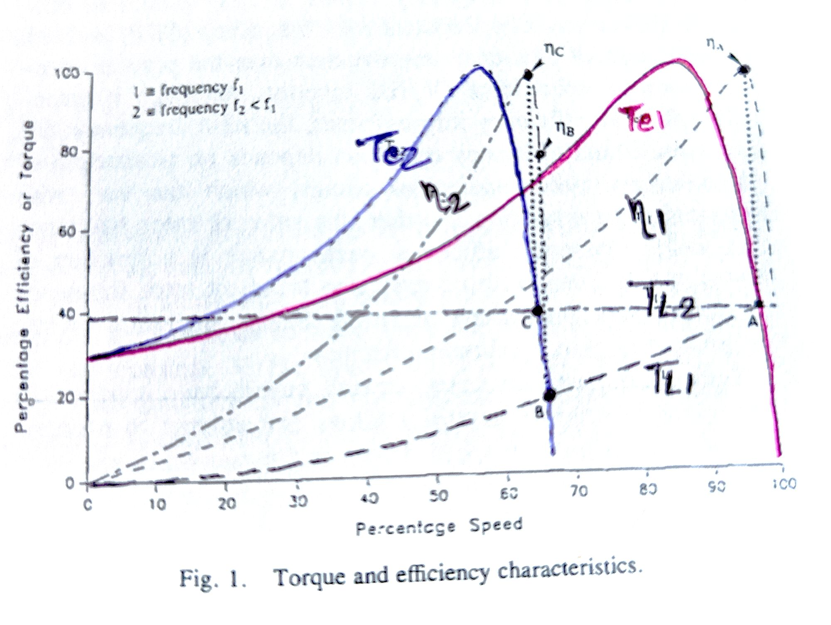
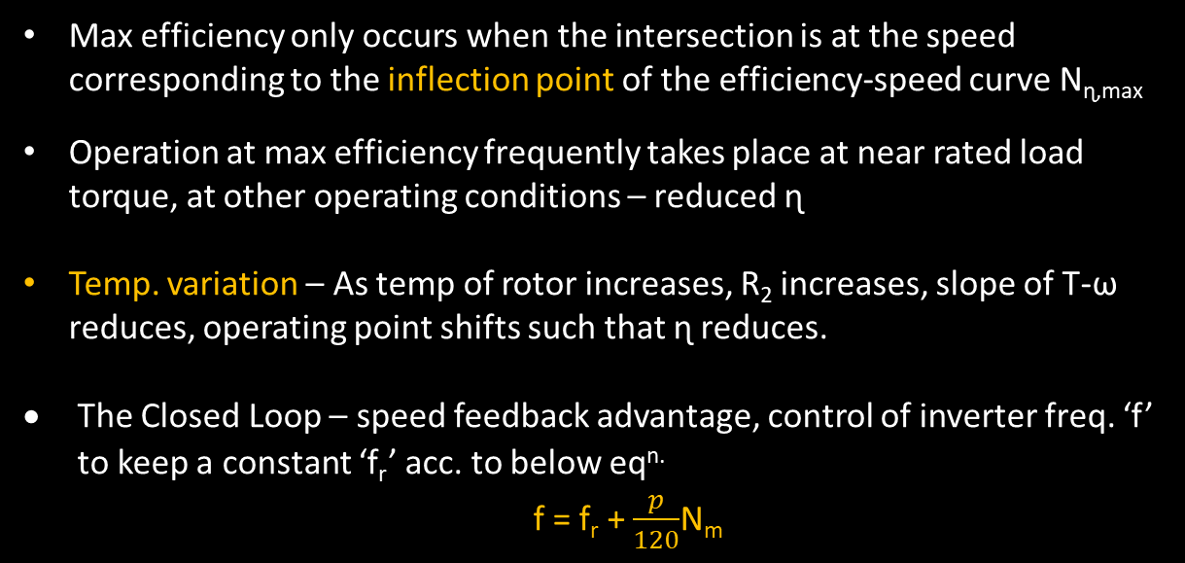
Literature Review
Max efficiency only occurs when the intersection is at the speed corresponding to the inflection point of the efficiency-speed curve N_{ɳ,max}
Operation at max efficiency frequently takes place at near rated load torque, at other operating conditions – reduced ɳ
Temp. variation – As temp of rotor increases, R₂ increases, slope of T-ω reduces, operating point shifts such that ɳ reduces.
The Closed Loop – speed feedback advantage, control of inverter freq. ‘f’ to keep a constant ‘f_{r}’ acc. to below eq^{n.}
f = f_{r} + $\frac{p}{120}$N_{m}
Chosen rotor freq. – at rated speed, voltage and freq. If this rated rotor freq. results in operation near to max efficiency point, then this closed-loop, constant rotor freq. (CRF) inverter can offer a small efficiency improvement over the open-loop constant V/f control.
But max efficiency operation = f^{n.} (eqv. circuit parameters, motor speed)
Max efficiency slip – more sensitive to rotor resistance than any other parameter (which itself varies with load profile, dynamic measurement – quite difficult, if at all possible)

Slide 4
Literature Review
Kirschen et al. offered a testing and implementation of perturbing controller to minimize loss for a field-oriented controlled IM. [3]
Mehanna presents an adaptive controller modification of CRF inverter to operate at optimal efficiency. (Similar to [3], except that the extra complexity of field-oriented control is not required) [4]
Since the adaptive controller can be realized by modification of a constant V/f inverter, this paper implemented and tested this concept.
Advantage of Perturbing rotor frequency (PRF) : No need of motor parameters knowledge. So, variation in parameters due to temperature and saturation has no consequences.

Slide 5
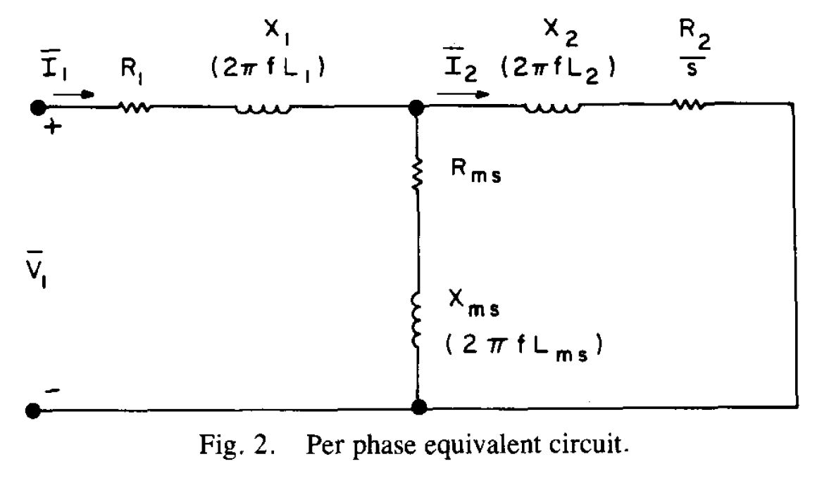

Theoretical Investigation
A) Efficiency Determination
Modified Steinmetz equations (to account for freq. effects) :
R₁ = R₁₀ + c₁f R₂ = R₂₀ +c₂(sf)^{α} R_{ms} = c_{m}f^{β}
where- R₁₀ and R₂₀ are the dc values of R₁ and R₂ , Constants c₁, c₂, α, β are determined from eqv. circuit evaluated at two frequencies
Let R_{2m} + j X_{2m} = (R_{ms} + j X_{ms}) II (R₂ / s + j X₂)
and ∆ = (R_{ms} + R₂ / s)² + (X₂ + X_{ms})²
P₁ = 3V₁²R₁ / [(R₁ + R_{2m})² + (X₁ + X_{2m})²]
P_{c} = 3[(R₂/s)² + X₂²]V₁²R_{ms} / ∆ [(R₁ + R_{2m})² + (X₁ + X_{2m})²]
P_{g} = 3(R_{ms}² +X_{ms}²)V₁² (R₂/s) / ∆ [(R₁ + R_{2m})² + (X₁ + X_{2m})²]
P_{R} = k_{N}ω_{m}²
where- P₁ = Primary copper losses P_{c} = Core losses P_{g} = Air gap power P_{R} = Rotation power losses
ω_{m} = (1 - s) ω_{s} = $\frac{\left(1−s\right)4 π f}{p}$
For p =4
P_{R} = k_{N}[ π (1 - s) f]²

Slide 6
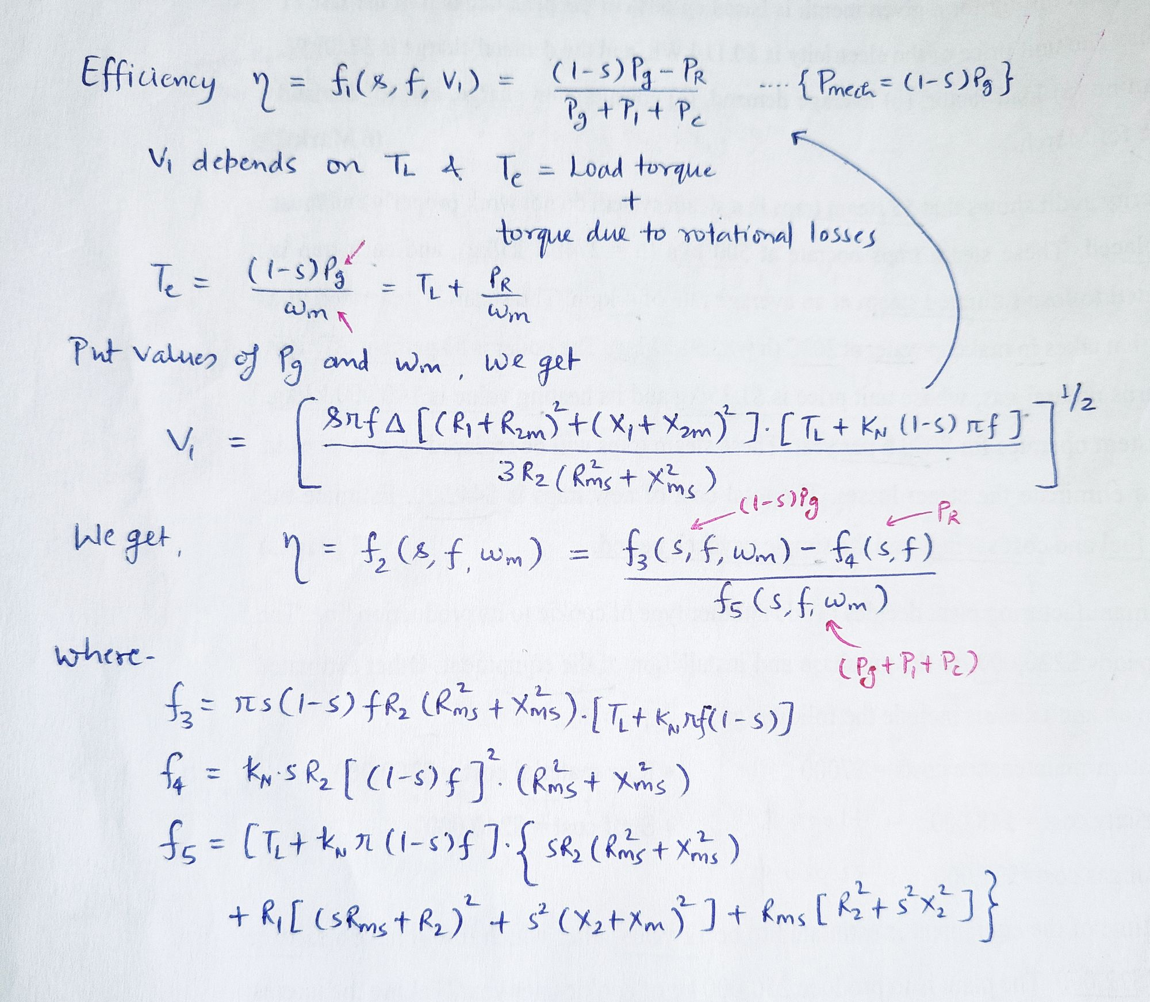
For 4 pole, s = (πf - ω_{m} ) / πf
ɳ = f₆ (f, ω_{m})
∂ɳ / ∂f = 0 → f = f_{ɳ max} (for a particular ω_{m}) → Max efficiency operation
Limited range search approach is used.
(f is varied by small increments until
f = f_{ɳ max} is determined)

Slide 7
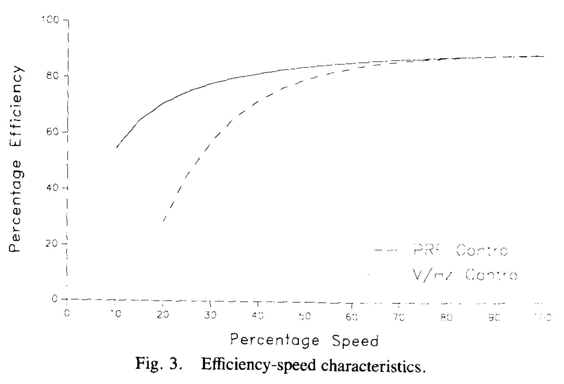
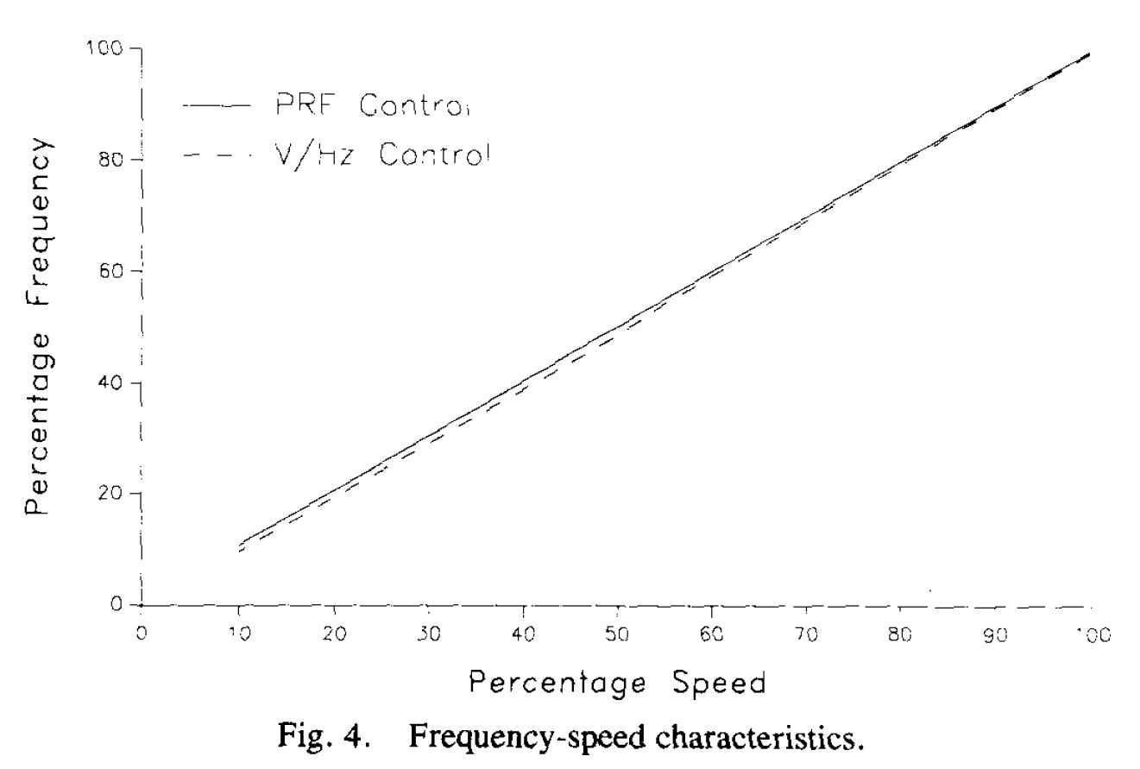
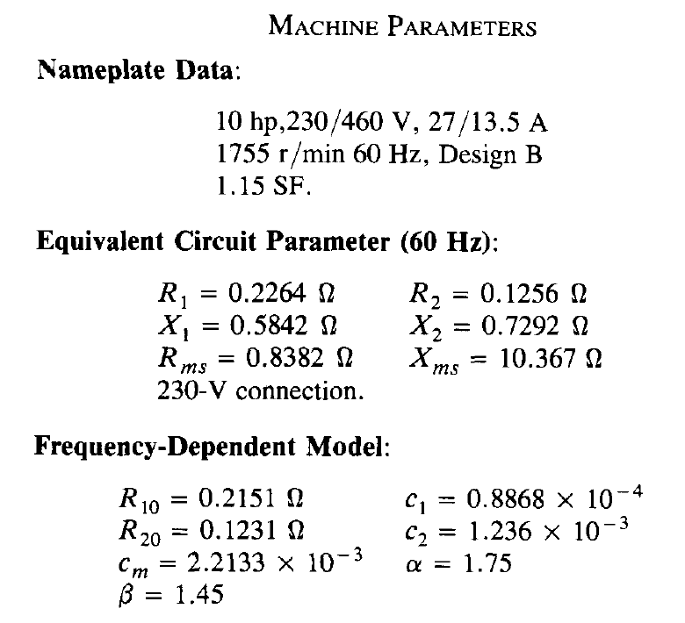
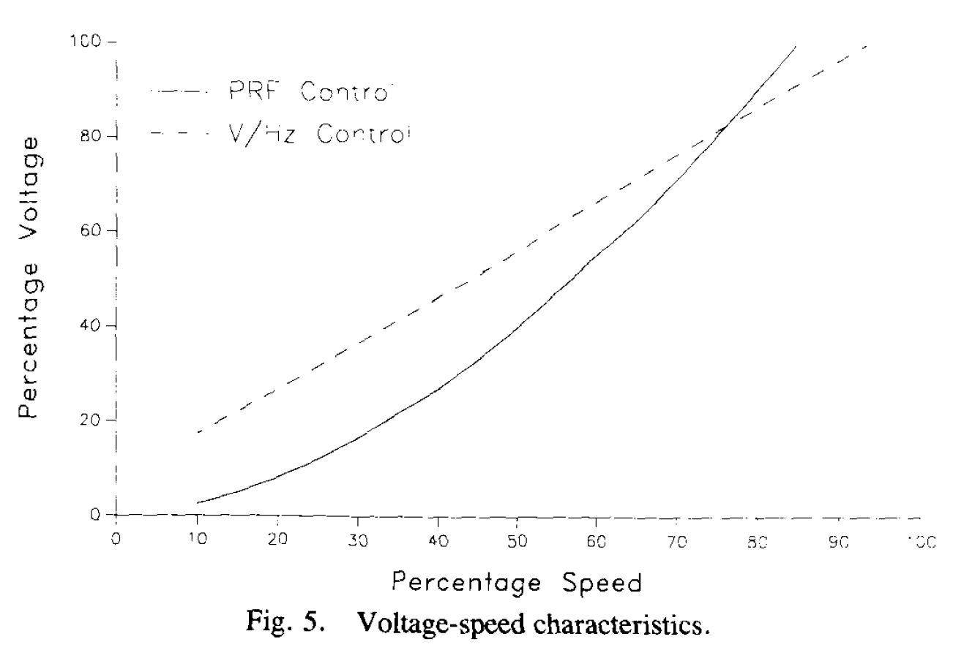
B) Theoretical Predictions
Results of theoretical study –
Fig 3 : significant efficiency improvement for speed < 65% by PRF control over constant V/f control
Fig 4 and 5 : Lower voltage and increase frequency → Lower core losses → Lower total losses

Slide 8
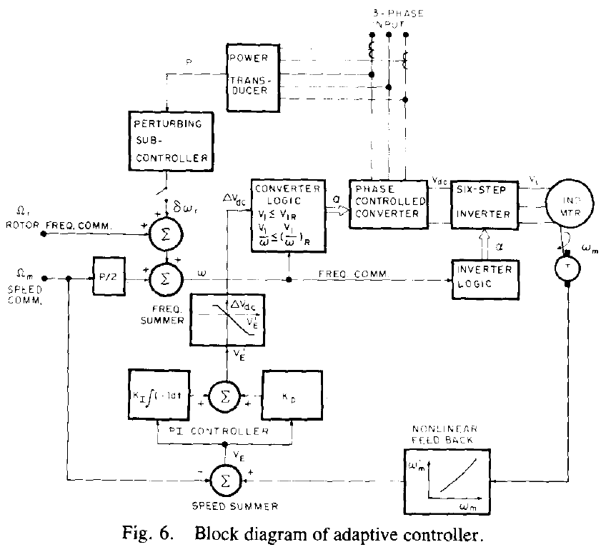
Experimental Investigation
A) Controller Realization
2 modes of operation – (i) constant rotor frequency control, (ii) perturbing control
If ω’_{m} > Ω_{m} : DC link voltage reduces If ω’_{m} < Ω_{m} : DC link voltage increases
Perturbing subcontroller senses P and change δω_{r}
If P reduces, another increment in previous direction If P increases, alter the direction
Inverter output freq. is adjusted until minimum input power is achieved.
An 8-b microprocessor-based implementation of the controller is used.
Speed is regulated

Slide 9
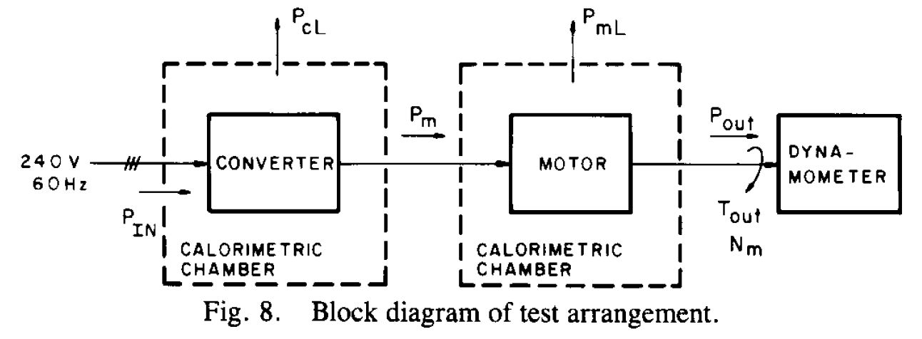
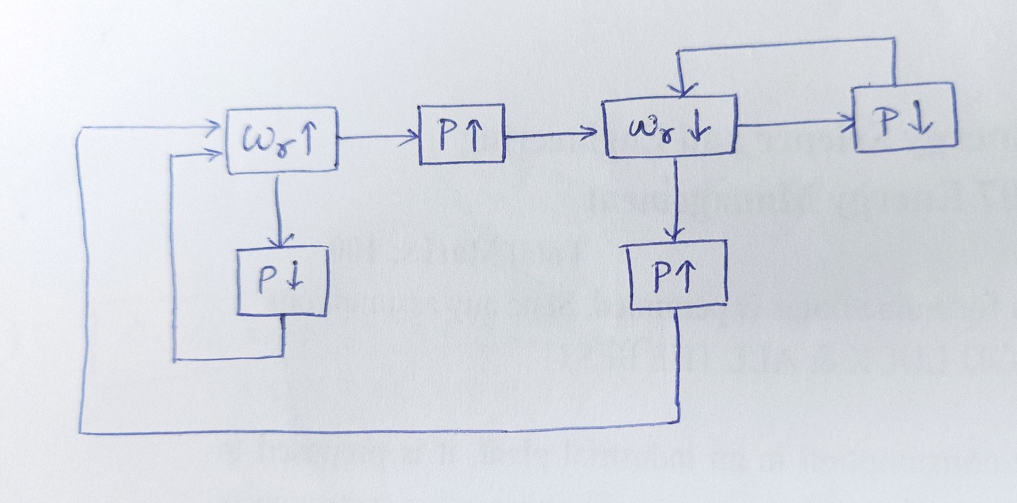
B) Test Descriptions
Two power conditioner-motor arrangements :
Standard-efficiency motor with constant V/f control
Standard-efficiency motor with perturbing rotor freq. control
Converter losses P_{cL} and motor losses P_{mL} : Measured by ‘Air calorimetric loss determination technique’
Test conducted : At 25, 50, 75 and 100% of rated speed
At each speed, shaft load torque of 1/4, 2/4, 3/4, 4/4 of 30 ft.lb (under steady state condition)
One additional point : 75% speed with 9/16 of 30 ft.lb

Slide 10
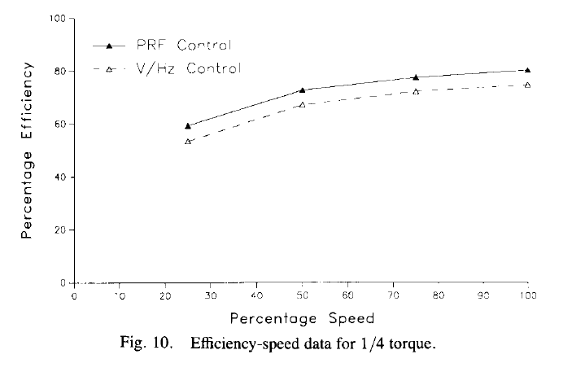
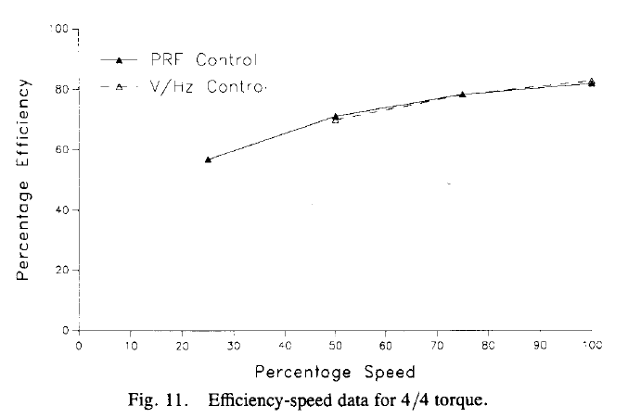
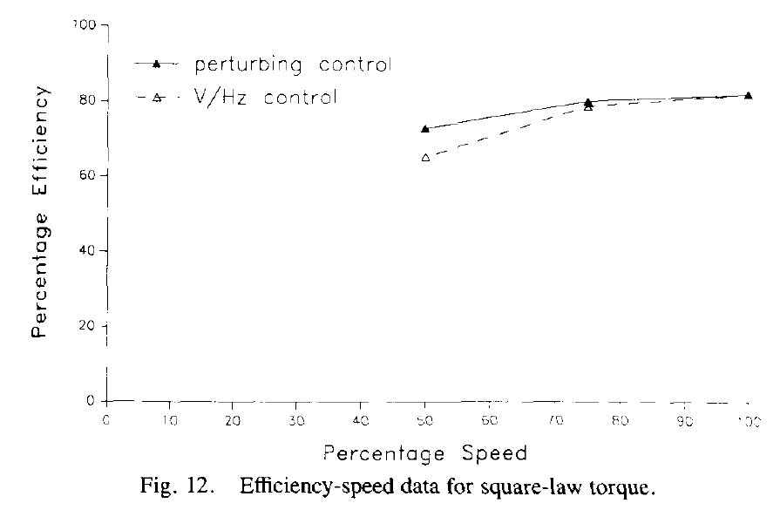
Results of Tests
Comparison of overall system efficiency for V/f and PRF control –
Fig 10 : For 1/4 torque
Fig 11 : For 4/4 torque
Fig 12 : PRF control is best suited for nonlinear torque type load
Experimental observations –
Using V/f control :
ɳ₁ = 78.6 % (at 75 % speed, 9/16 of rated torque)
and ɳ₂ = 65.27 % (at 50 % speed, 1/4 of rated torque)
Using PRF control :
ɳ₁ = 78.6 + 1.4 = 80 %
and ɳ₂ = 65.27 + 7.46 = 72.73 %

Slide 11
Conclusion
Significant efficiency improvement → For reduced loads at all speeds
Small efficiency improvement → For near rated loads at low speeds
Greatest efficiency improvement for loss minimization control with non-linear torque-speed loads.

Slide 12
References
P. Famouri and J. J. Cathey, "Loss minimization control of an induction motor drive," in IEEE Transactions on Industry Applications, vol. 27, no. 1, pp. 32-37, Jan.-Feb. 1991.
A. Kusko and D. Galler, “Control means for minimization of losses in ac and dc motor drives,” IEEE Trans. Industry Applications, vol. IA-19, no. 4, pp. 561-570, July-Aug. 1983.
D. S. Kirschen, D. W. Novotny, and T. A. Lipo, “Optimal efficiency control of an induction motor drive,” IEEE Trans. Electron. Comput., vol. EC-2, no. 1, pp. 70-76, Mar. 1987.
C. Y. Mehanna, “Perturbing controller for minimum loss operation of induction machines,” M.S. thesis, Univ. Kentucky, Aug.1985.

Slide 13
Thank You

Slide 14
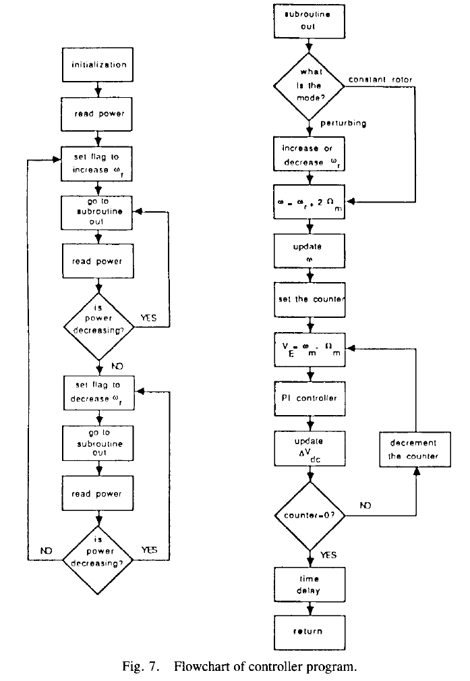

Slide 15
